Slide 1
Hello and welcome to
Our Future Heroes Hospice Care session, we will begin shortly.
Please mute your mics and switch off your cameras.
If you need technical assistance please use the chat box and we will be happy to help.

Slide 2
House keeping
Please mute your microphone and turn off your cameras. This will help us manage background noise during the presentations.
Please do not take any recordings or screen shots of the screen during the session
If you need any technical help during the event please message us using the chat box.
If you would like to ask a question please use the chat box.
The session will be not be recorded live but we will be uploading the presentations to the Extra Heroes webpage after this session.
Please bear with us if there are technical issues we will resolve them as quickly as possible. You may find that some of the videos we play may buffer, we will share the links after the event for anyone who had any issues watching them.
Social media – please tag us in @hwe_academy and #Future Heroes
Please join in with the quizzes and activities
Your feedback is important to use please feel free to email us – academy.hwe@nhs.net

Slide 3
Rewarding Careers in a Hospice
Su Bennett & Karenann Spicer

Slide 4
What is a Hospice?
We can help people who are managing, or recovering from, serious illness. We help them to live your life well by improving symptoms, working with them to achieve personal goals - helping them to feel safe - and anything from getting back to work, enjoying family time to walking the dogs again.
Our care takes many forms and our professional team plus dedicated, trained volunteers care for people with a wide range of illnesses including cancer, motor neurone disease, dementia, heart disease, lung disease and neurological illness.
We can help patients in their own home or at the Hospice through 1:1 appointments or group sessions (anything from physio to nursing support and mindfulness to complementary therapy) in our Spring Centre or through 24-7 care in our beds.

Slide 5
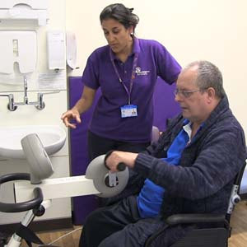
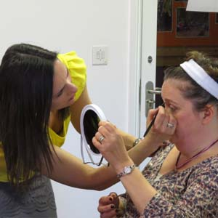
Adults and Children's Hospices

Slide 6
Hospices are part of something bigger

Slide 7
Key Facts about Hospice
220 hospices across UK of which there are 54 children's hospices
225,000 people are supported each year
72,000 bereaved people are supported
90% of care is community based
Adults 32% funded v Children’s 17% (NHS)

Slide 8
This is What it Takes!
https://www.facebook.com/79167888410/videos/339603067329545

Slide 9
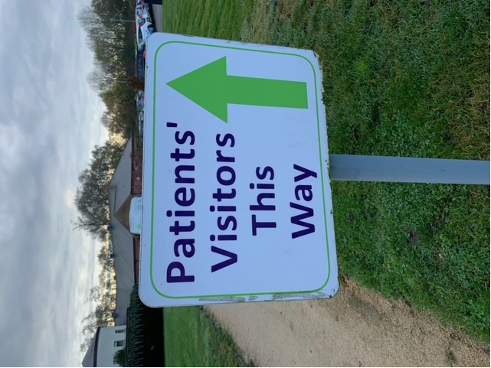
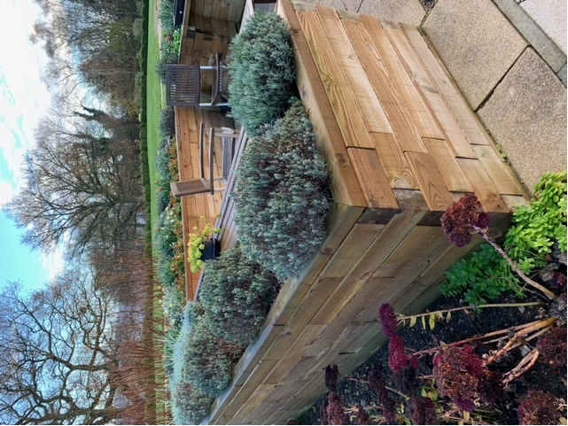
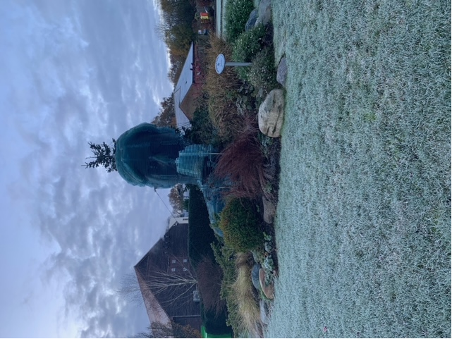
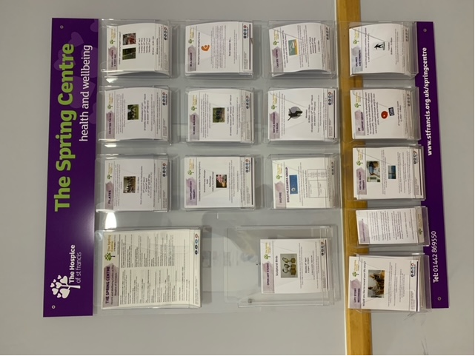
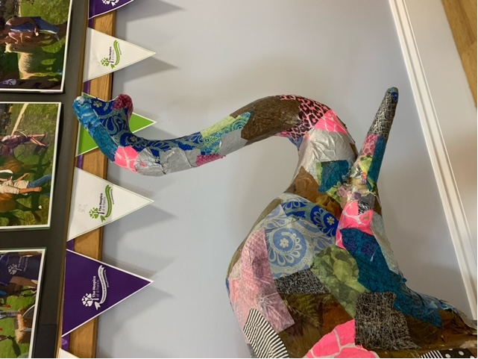
Where is this?

Slide 10
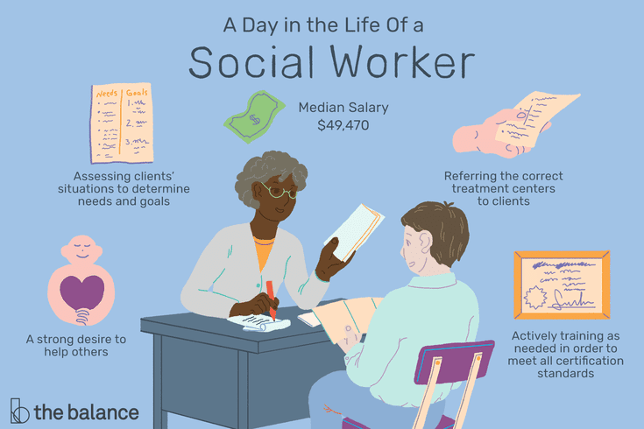
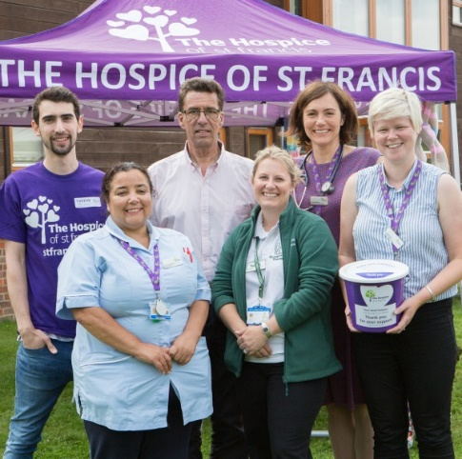
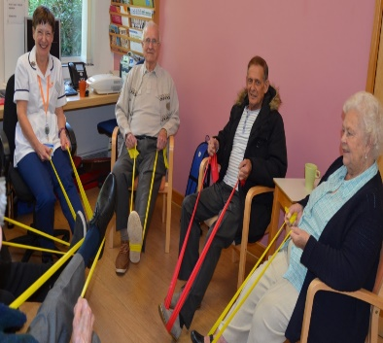
Careers in Hospices

Slide 11
Why volunteer?
Our team of over 1,450 volunteers is implicit to the work of the Hospice of St Francis. They help to raise money, care for patients, welcome visitors, support families, highlight our work in the community and keep everything running smoothly. Our volunteers go the extra mile and ensure that all of our patients and their loved ones receive ‘total care when time is precious.’
The Hospice has over 80 voluntary roles!

Slide 12
Volunteering at The Hospice of St Francis
Duke of Edinburgh – from the age of 14 you can apply to volunteer in one our shops – gain experience of working with the public and volunteer alongside people from all walks of life.
*Inpatient Unit - Students wanting to go into medicine or other roles in a healthcare field are welcomed to apply to join the Inpatient Unit team to help gain experience in this field, and discover whether palliative care is the right avenue for them. Volunteers must have finished their GCSE year and be 16 years or over to apply
*Work Experience - A limited number of work experience opportunities is now available for students within our catchment area in year 12. Students will be placed in a specific role, in order to enhance their studies, or they will be given an opportunity to work with various teams, gaining an overview of the work of the Hospice
College Work Experience placements – If you are at college (16-18) and looking for longer term work experience placements, please contact us there are range of opportunities including working in our Gardens, our Online Hub and one off projects.
*Work experience for yr. 12 and inpatient unit volunteering is very limited at the moment due to the pandemic

Slide 13
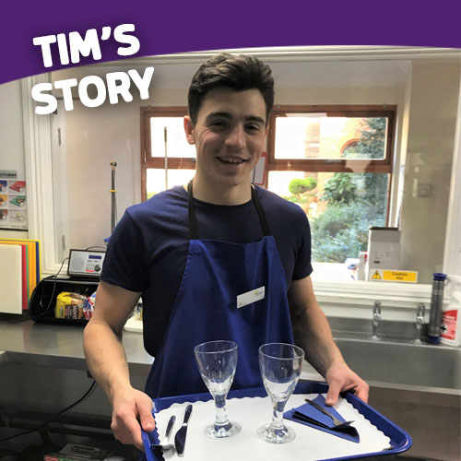
Case Studies – Meet Tim
Meet Tim, 18, an Inpatient Unit Volunteer. “I knew how rewarding it is to take part in any volunteering, especially within my local community, but volunteering here has offered the opportunity to work within a medical environment… Tim explains that the role gives him the chance to see first-hand the work that the Hospice does, offering a hand in the darkness to patients and families, and helping them feel safe. “By being part of the direct patient care you get to understand the community that exists within The Hospice of St Francis. It is difficult to find experience in the healthcare setting while being under the age of 18, so this was particularly valuable to me as a student. I’ve applied to study medicine and I hope to go to Uni this September, so volunteering is hopefully the first step of my medical journey!”

Slide 14
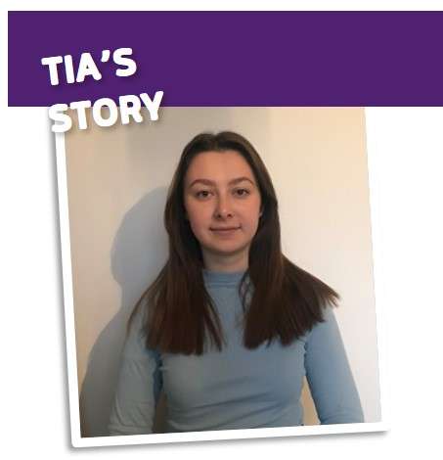
Case Studies – Meet Tia
Meet Tia. She’s currently taking a gap year, working at a supermarket, she’s been volunteering with our Inpatient (IPU) team for over two years, working an evening shift every month – serving dinner and drinks to patients and washing up in the kitchen.
Here she shares her story of how she came to be part of the Hospice volunteer team, and how it helped her decide which career path she would like to pursue…
“When I started volunteering at the Hospice, I wanted to do something in healthcare but I wasn’t sure what. I came to realise nursing was what I would like to pursue. Meeting the nurses and gaining first-hand experience of their day-to-day life made me realise that’s what I want to do.”
Originally thinking of the Hospice as a sad place to be, Tia describes how she quickly came to realise the ‘community’ that is there – “It really opened my eyes to how the staff and volunteers work together to make times of sadness more bearable for families and loved ones.

Slide 15
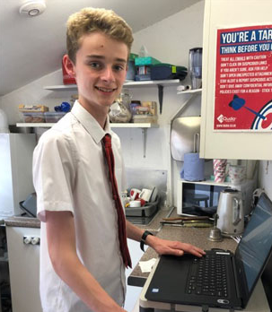
Case Studies – Meet Daniel
Meet Berkhamsted Shop volunteer and year 10 student Daniel.
He helps the staff in the shop by registering the online gift-aid claims that enable the shop to claim tax back on the daily sales as well as logging new gift aid customers on the computer.
“I live and study locally and I like to support local causes whilst at the same time enhancing my skills. Everyone in Berkhamsted knows of the great work of the Hospice and their focus on end of life care.”
Daniel also adds, “I also help by sorting through donations, restocking shelves, general tidying up and maintenance of the shop. I began volunteering for an hour and a half a week after school as part of my Duke of Edinburgh Bronze award but decided to keep doing it to support my local community. The staff in the shop have told me that since I have been there the difference I am making means that they have been able to leave on time. It’s only a short time out of my week and I feel good that the hospice benefits from my volunteering.

Slide 16
A Great Place to Volunteer!
In 2019 we were privileged to have been given the Queens Award for Voluntary Services
Our comms team produced this video to support our application.
https://youtu.be/nH861genNKs

Slide 17
Name a Role in the Hospice
Please use the chat box to let us know

Slide 18
True or False
Hospices are places where people go to die?
They are sad depressing places to work
Hospices are part of the NHS
There are some hospices who only work in the community
There are hospices for children and adults

Slide 19
Links
https://www.stfrancis.org.uk/
https://www.stfrancis.org.uk/support-us/volunteer/how-can-i-help-
https://www.stfrancis.org.uk/work-with-us/current-vacancies
https://www.linkedin.com/company/hospice-of-st-francis-berkhamsted
https://www.facebook.com/thehospiceofstfrancis
https://www.instagram.com/hospicestfrancis/?hl=en

